Slide 1
Module 16

Slide 2
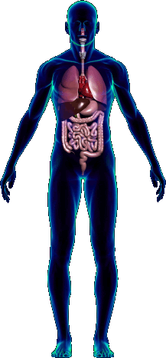
lungs
Imagine this is a heart….
Now let us study the working of the heart.
Pulmonary veins
Vena cava
1
2
Body
Pulmonary artery
R A
L A
Aorta
valve
Now the blood passes into the right ventricle through the valve.
The oxygenated blood from the lungs is brought into the left atrium by the pulmonary veins.
Now the blood passes into the left ventricle through the valve.
The deoxygenated blood from the body is brought into the right atrium by both the vena cava.
From the left ventricle, the oxygenated blood is supplied to all the parts of the body through the aorta.
From the right ventricle, the deoxygenated blood is carried to the lungs for oxygenation by the pulmonary artery.
valve
3
4
R V
L V

Slide 3
In one cycle the blood passes through the heart twice.
Therefore, the circulation in human beings is known as
Double Circulation

Slide 4
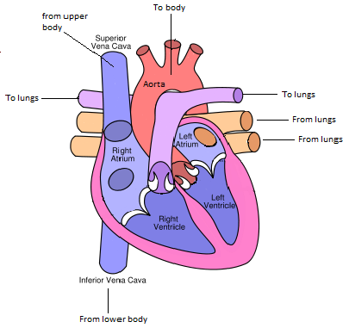
Vertical section of human heart
..Diagram

Slide 5
Thank You

